Slide 1
Accessibility Annual Status – 2019 Update

Slide 2
Accessibility Status Report
This Accessibility Status Report serves as an update on the progress towards meeting the planned initiatives listed in Haldimand County’s 2017-2022 Accessibility Plan and implementation of the Accessibility for Ontarians with Disabilities Act, 2005 (AODA) and the Integrated Accessibility Standards Regulation (Ontario Regulation 191/11). The 2019 Accessibility Compliance Report was submitted to the Government of Ontario in December 2019.

Slide 3
Haldimand County’s Commitment to Accessibility Planning
Through accessibility planning and with the advice of the County’s Accessibility Advisory Committee, Haldimand County will strategically identify, remove and prevent as many barriers as possible.
Haldimand County Council is Committed to:
The continual improvement of access to all municipally owned facilities, premises and services for all those with disabilities.
The provision of quality services to all members of the community with or without disabilities.

Slide 4
Objectives of the 2017-2022 Accessibility Plan
The Accessibility Plan describes the measures that Haldimand County will take in terms of the plan to identify, remove and prevent barriers for people with disabilities who utilize the goods, services and facilities of Haldimand County.
The Plan:
Describes the process by which the County will identify, remove and prevent barriers to people with disabilities.
Review earlier efforts to remove and prevent barriers to people with disabilities.
Review the facilities, policies, programs, practices and services in the County to identify barrier to people with disabilities.
Describe the measures the County will take in terms of the plan to identify, remove and prevent barriers to people with disabilities.

Slide 5
Accessibility Successes in 2019
General Initiatives
Continued to implement the County’s multi-year Accessibility Plan, 2017-2022 which has been posted on the County’s website and is available in an accessible format, upon request.
Filed 2019 Accessibility Compliance Report with the province.
Prepared the Annual Status Report of measures set out in the multi-year accessibility plan, posted it on the County’s website and provided it in an accessible format, upon request.
Accessibility policies and procedures posted on website and provided in an accessible format, upon request.
Continued to implement purchasing policy, which requires suppliers and their staff to comply with the AODA when acquiring goods, services and facilities.

Slide 6
Accessibility Successes in 2019 – Customer Service
Service disruption notices were posted at affected facilities, on the County’s website and communicated through social media channels.
Provided alternative facilities or services where possible.
The comprehensive Accessible Customer Service Policy has been posted on the County’s website and provided in an accessible format, upon request.
Continued to raise awareness about accessibility through the Fall/Winter and Spring/Summer Community Guides distributed to all residents.
Provided on-going training to Accessibility Advisory Committee Members, volunteers and new staff.

Slide 7
Accessibility Successes in 2019 – Information and Communications
Training on the creation of accessible documents was provided to numerous staff.
Several forms and documents on the Haldimand County website were updated to be fillable accessible PDF’s.
Continue to receive and follow up on feedback in regards to our goods, services and facilities.
Continue to ensure processes for receiving and responding to feedback are accessible for persons with disabilities by providing/arranging for accessible formats and communications supports, upon request.
Completed the redesign of the County’s website to meet the WCAG 2.0 Level A standard for accessibility.

Slide 8
Accessibility Successes in 2019 – Design of Public Spaces / Sidewalks
New sidewalks were updated to accessible standards (1.5 m width increased to 1.8 m) and tactile warning plates were installed at cross walks as part of the following projects:
Alder Street Reconstruction – John Street to West Street (Dunnville)
Argyle Street Resurfacing – Grand River Bridge to Braemar Street (Caledonia)
Haddington Street Resurfacing – Argyle Street to Wigton Street (Caledonia)
Lafayette / Boyd / Monson Street Resurfacing (Jarvis)

Slide 9
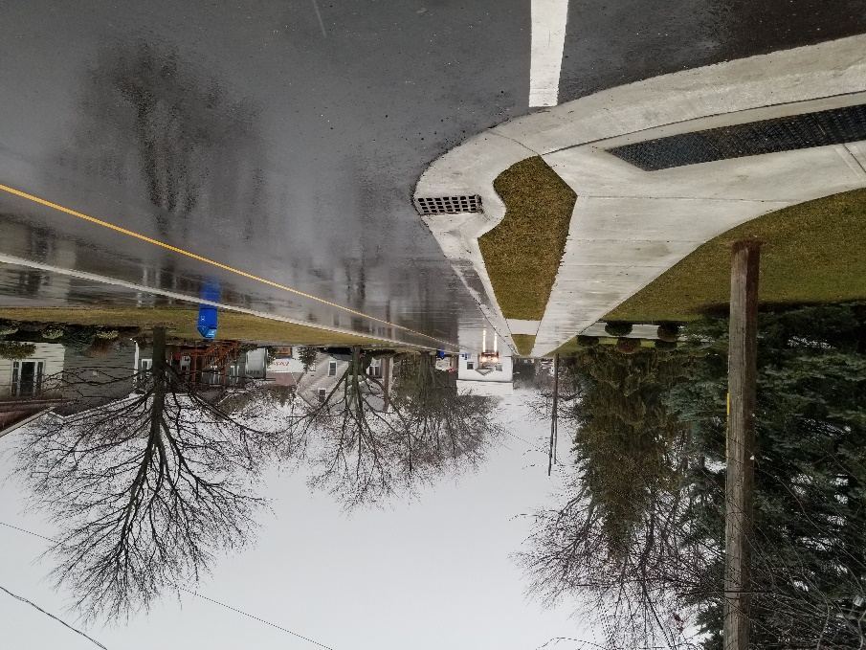
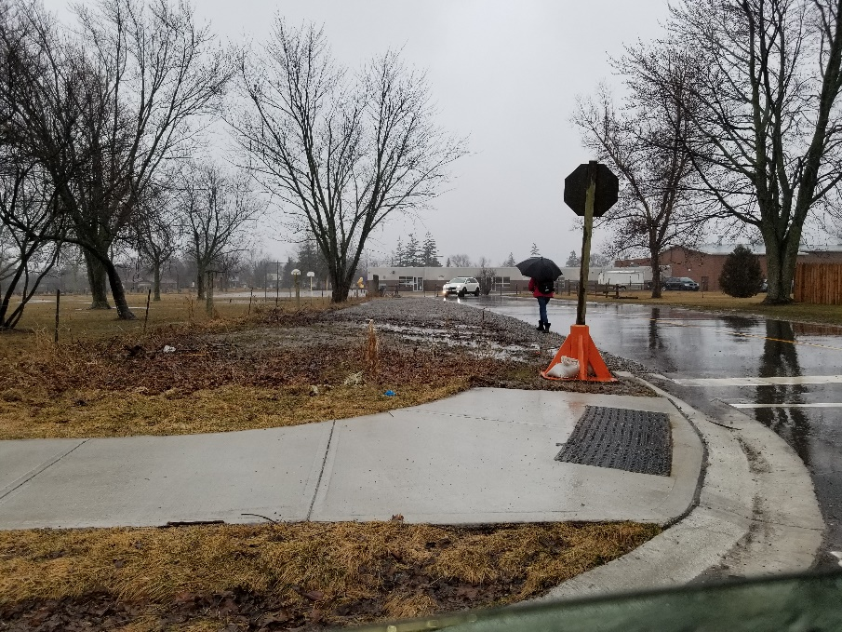
Accessibility Successes in 2019 – Design of Public Spaces / Sidewalks (Continued)
Pictured below - Lafayette / Boyd and Monson Street Resurfacing project in Jarvis with new curbing, sidewalks and tactile plates.

Slide 10
Accessibility Successes in 2019 – Design of Public Spaces / Trails, Parking and Seasonal Patios
Trail slope paving of the Cayuga Grand Vista Trail from the Courthouse to the bottom of the hill.
New on-street accessible parking spaces were installed in front of Hagersville United Church.
The Accessibility Advisory Committee was consulted on the seasonal patio program and several applications made under program to ensure patios were accessible to persons with disabilities.

Slide 11
Accessibility Successes in 2019 – Design of Public Spaces / Outdoor Play Spaces and Parks
Consulted with the Accessibility Advisory Committee on the new construction or redevelopment plans for the following County parks:
Thistlemoor Playground equipment replacement - inclusive playground features
Burke Park Playground equipment replacement - accessible & inclusive playground features
Dunnville Kinsmen Park Playground equipment replacement - inclusive playground features
Dunnville Lions Park Playground equipment replacement - accessible & inclusive playground features
Oswego Park Playground equipment replacement - inclusive playground features

Slide 12
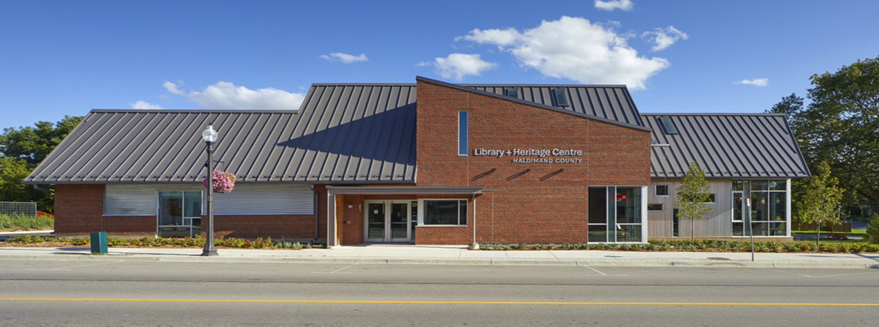
Accessibility Successes in 2019 – Design of Public Spaces / Facility Enhancements and Renovations

Slide 13
Accessibility Successes in 2019 – Design of Public Spaces / Facility Enhancements and Renovations (Continued)
Completion of the new Cayuga Library & Heritage Centre which includes accessible service counters, automatic door openers, a fully accessible washroom and accessible wayfinding signage.
The Accessibility Advisory Committee provided comments on the renovation or new construction of the following County facilities:
Haldimand County Caledonia Centre – office space altered to create an accessible counter and washroom.
Haldimand County Administration Building – accessible wayfinding signage to be installed that includes colour contrasting and tactile signage.
Townsend Lions Washrooms - added an accessible washroom in an existing facility.
Wilson Macdonald Museum Washroom - created an accessible washroom in the existing facility

Slide 14
Accessibility Successes in 2019 - Employment
Continue to notify the public about the availability of accommodation for applicants with disabilities in the recruitment process.
Acknowledgement statement on job applications includes statement of availability of accessibility accommodations in recruitment process.
Continue to notify candidates for employment of the availability of accessibility accommodations when contacted for an interview or assessment.
Offered support to employees who require temporary or permanent work accommodation and maintain a return to work employment accommodation program.
Continue to inform new employees of policies and procedures to support employees with disabilities during on-boarding and orientation.

Slide 15
Accessibility Successes in 2019 - Transportation
In the absence of public transit, continued to communicate and advise private transportation companies (Taxicab Operators and Drivers) on the requirements of the Transportation Standard including fare restrictions and the posting of vehicle registration and identification information.
Monitored Taxi industry and ensured compliance with Accessible Taxicab requirements.
Ensured Accessible Taxicabs meet all safety requirements stipulated through the County’s Hired Vehicle Licensing By-law.
Continued to ensure every licensed driver of an Accessible Taxicab notifies passengers upon arrival, offers such assistance as the passenger requires, and properly and safely handles passenger mobility aids.

Slide 16
2020 Goals and Next Steps
Review, update and obtain Council adoption of Accessibility Design Guidelines for the County facilities.
Undertake a comprehensive review of the County’s 2017-2022 Accessibility Plan and update where appropriate based on changes stemming from the County reorganization in 2018.
Work with Emergency Services staff to ensure emergency preparedness and response policies provide for the safety of persons with disabilities and make these policies available to the public and provide in an accessible format, upon request.
Provide input into the Accessibility Consultation requirements as part of the Parks Master Plan development.

Slide 17
2020 Goals and Next Steps
Continue to consult with the County’s Accessibility Advisory Committee on various capital projects and changes to existing services.
Continue to monitor and update existing accessibility policies, as appropriate.
Continue to review customer feedback and make changes, where appropriate.
Work with the Accessibility Advisory Committee to develop a public awareness campaign concerning service animals and accessible parking.
Continue to keep abreast of accessibility issues, innovations and trends.
Continue to develop accessible templates and create accessible documents, to improve access to information.
Continue to consult the public, persons with disabilities and the Accessibility Advisory Committee

Slide 18
Contact Information
For more information about accessibility initiatives within the County or to obtain a copy of this presentation in an alternative format, contact the County’s Deputy Clerk:
Phone: 905-318-5932, ext. 6362
E-mail: accessibility@haldimandcounty.on.ca
Mail: Deputy Clerk / Accessibility Liaison
Citizen & Legislative Services Division
Haldimand County Administration Building
53 Thorburn Street
Cayuga, ON N0A 1E0

Slide 19
Feedback
Haldimand County invites public input to help identify barriers where changes need to be made to improve access to County facilities, goods and services. Should a member of the public wish to provide general feedback, comments or suggestions on how to improve accessibility in the County, please contact the Deputy Clerk / Accessibility Staff Liaison.

